Slide 1
Operating systems
Cooperating Process

Slide 2
Content Lecture#9
01
Concurrent process
02
Cooperating Process
03
Critical Section
04
Solution to critical Section
05
Invalid Solution to critical section

Slide 3

Lets take a Break
A programmer had a problem, so he used threads. Then he had two problems.

Slide 4
Cooperating Process
A process is cooperating if it can affect or be affected by the other processes executing in the system
Critical Section
Part of the program where shared memory is accessed is called critical section

Slide 5
Concurrent Process
Many processes can be executed concurrently to perform multitasking on a CPU due to following reasons
  To share system resources in a multi-user environment
  To share data/database
  To breakup a task into subtasks, each execute in parallel
  Parallel execution of tasks like editing, spell checking, printing and compiling
In concurrency, the issues of cooperation among the processes, synchronization and communication are very important
Such a process has the following characteristics
  Its state is shared among other processes
  The result of its execution cannot be predicted because of relative execution
  The result of its execution is non deterministic.

Slide 6
Cooperating Processes
A process is cooperating if it can affect or be affected by the other processes executing in the system
We provide an environment that allows process cooperation due to following reasons
Information sharing
  Many users or processes may be interested in the same piece of information
Computation speedup
  We breakup process into subtasks which run in parallel
Modularity
  We want to construct the system in modular fashion, dividing the system functions into separate threads
Convenience
  A user can do editing, printing and compiling in parallel

Slide 7
Critical Section
Part of the program where shared memory is accessed is called critical section, or
The area of a process which is sensitive to inter-process complications is called critical section or critical region
Following are the four conditions to hold for a good solution
  No two processes may be simultaneously in their critical sections
  No assumptions may be made about speeds or number of CPUs
  No process running outside its critical section may block other process
  No process should have to wait forever to enter in its critical section

Slide 8
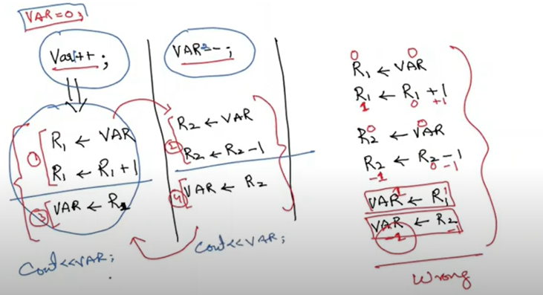
Critical Section

Slide 9
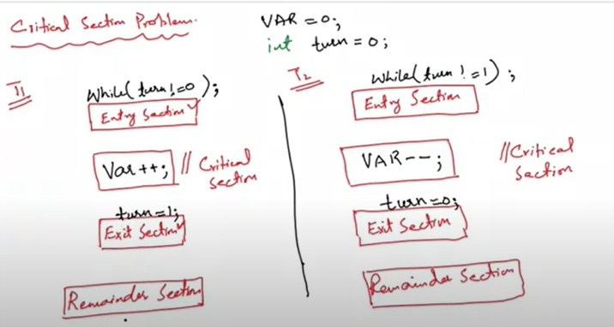
Critical Section Solution
Both threads enter their critical section at the same time so the solution

Slide 10
Mutual Exclusion
A condition in which there is a set of processes, only one of which is able to access a given resource or perform a given function at any time
Suppose two or more processes require access to a single non-sharable resource, such as printer
  Each process will be sending data to the printer through critical section of each process
  It is important that only one program at a time be allowed in its critical section
  One cannot rely on operating system to enforce this restriction, therefore the processes have to be controlled

Slide 11
Solution to Critical Section Problem
Mutual Exclusion
  If process Pi is executing in its critical section, then no other processes can be executing in their critical sections
Progress
    Thread and/Process running in their remainder section should not participate in decision making
    Decision making should not be indefinitely prolonged (timely manner)
  If no process is executing in its critical section and there exist some processes that wish to enter their critical section, then the selection of the processes that will enter the critical section next cannot be postponed indefinitely
Bounded Waiting
  A bound must exist on the number of times that other processes are allowed to enter their critical sections after a process has made a request to enter its critical section and before that request is granted
  Assume that each process executes at a nonzero speed
  No assumption concerning relative speed of the n processes

Slide 12
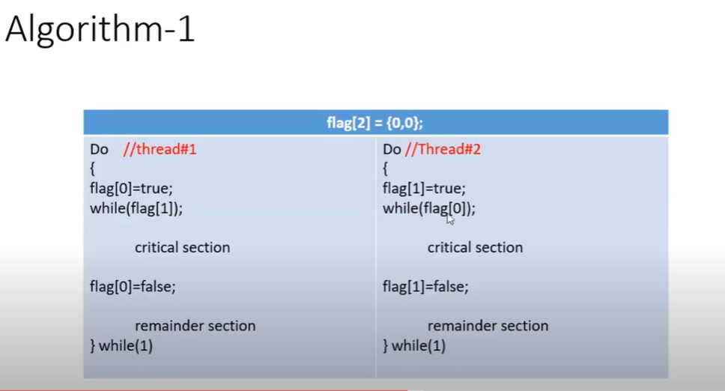
Solution to Critical Section Problem

Slide 13
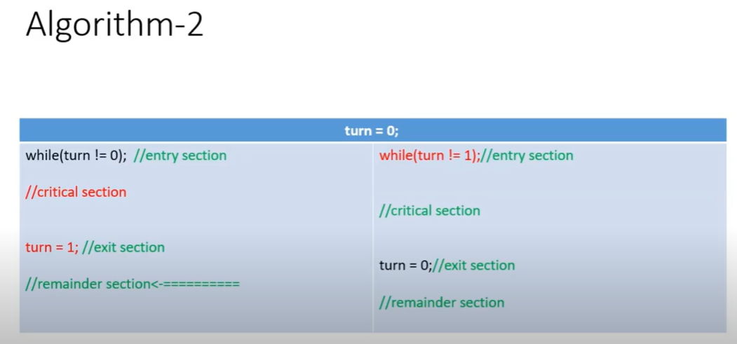
Solution to Critical Section Problem

Slide 14
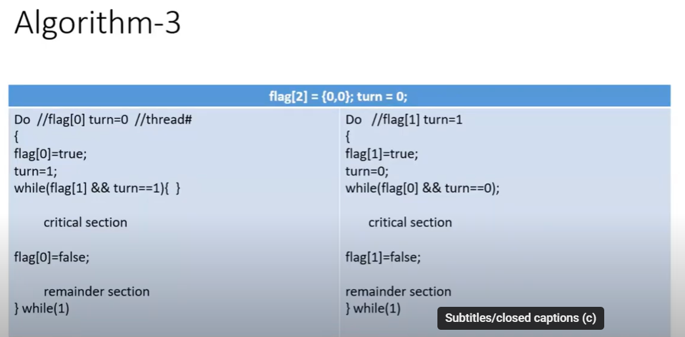
Solution to Critical Section Problem

Slide 15
Invalid solution critical section
Starvation (bounded waiting violation)
Deadlock (Progress violation)
Mutual exclusion violate

Slide 16
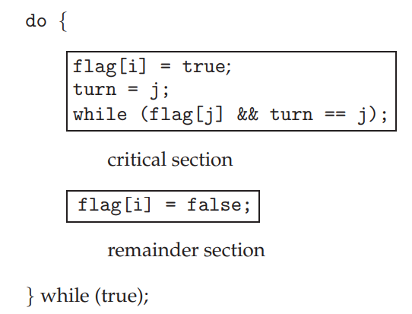
Peterson’s Solution
int var = 0; int flag[2] = {0,0}; int turn =0;
void* increment (void* ptr)
{
for (int i=0;i<1000000;i++)
{
flag[0] = 1;
turn=1;
while(flag[1]==1 && turn ==1); //entry section
var++; //critical section
flag[0]=0; //exit section
}
}
void* decrement (void* ptr)
{
for (int i=0;i<1000000;i++)
{
flag[1]=1;
turn=0;
while(flag[0]==1 && turn ==1); //entry section
var--; //critical section
flag[1]=0; //exit section
}
}
int main()
{
pthread_t tid1,tid2;
pthread_create(&tid1,NULL,&increment,NULL);
pthread_create(&tid2,NULL,&decrement,NULL);
pthread_join(tid1,NULL);
pthread_join(tid2,NULL);
printf("%d\n",var);
return 0;
}
Peterson’s solution is restricted to two processes that alternate execution
between their critical sections and remainder sections.

Slide 17
Hardware Solution
Context switch is done by timer interrupt. If we disable the timer interrupt then time slice won’t get expired, hence no synchronization issue.
How to disable interrupts
  CLI(Clear Interrupt Flag) instruction
  SDI(Set Interrupt Flag) instruction
    Flag register bit reserved for interrupt
  They are privileged and cannot run in user mode
  In Assembly language to do it “asm(cli)” if it works it will disable all of the keyboard and mouse

Slide 18
Hardware Solution
CPU provides some instruction in its ISA that can execute atomically
Atomically means its execution cannot be interrupted once its issued even on a multicore system.
Such instruction once issued are committed.

Slide 19
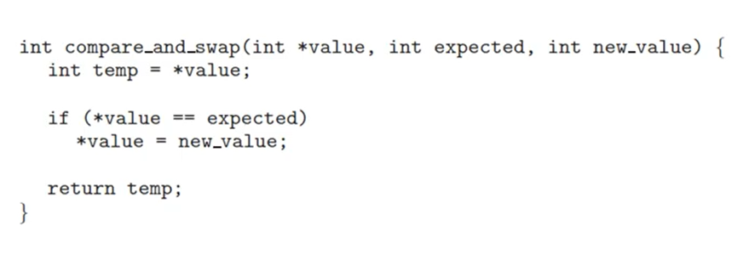
Atomic Instruction

Slide 20
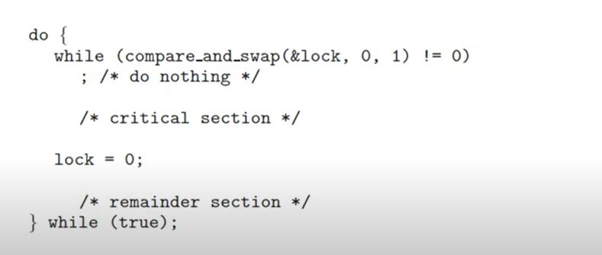
Use of atomic instruction

Slide 21
Passing arguments
int sum1 = 0 , sum2 = 0;
void* add1 (void* ptr)
{
int* num =(int*) ptr;
for (int i=0;i<5;i++)
sum1 += num[i];
return NULL;
}
void* add2 (void* ptr)
{
int* num =(int*) ptr;
for (int i=0;i<5;i++)
sum2 += num[i];
return NULL;
}
int main()
{
pthread_t tid1, tid2;
int number[10] = {9,7,8,6,5,4,3,1,2,7};
pthread_create(&tid1,NULL,&add1,(void*)number);
pthread_create(&tid2,NULL,&add2,(void*)&number[5])
pthread_join(tid1,NULL);
pthread_join(tid2,NULL);
int sum = sum1+sum2;
printf("Sum is %d", sum);
return 0;
}

Slide 22
Microsoft says
Each process provides the resources needed to execute a program. A process has a virtual address space, executable code, open handles to system objects, a security context, a unique process identifier, environment variables, a priority class, minimum and maximum working set sizes, and at least one thread of execution.
Each process is started with single thread, often called primary thread, it can create additional threads from any of its threads.
Each process provides the resources needed to execute a program.
All threads of a process share its virtual address space and system resources.
In addition, each thread maintains exception handlers, a scheduling priority, thread local storage, a unique thread identifier, and a set of structures the system will use to save the thread context until it is scheduled.
The thread context includes the thread's set of machine registers, the kernel stack, a thread environment block, and a user stack in the address space of the thread's process.
Threads can also have their own security context, which can be used for impersonating clients.
https://docs.microsoft.com/en-us/windows/win32/procthread/about-processes-and-threads

Slide 23
Solaris threads
Solaris 2 is based on Unix with support for threads at the kernel and user levels
It introduce an intermediate level between kernel and user level threads which is called LWP(light weight process)
Resource needs of threads;
  Kernel thread
Small data structure and stack
Thread switching does not require changing memory access information
It is relatively fast
  LWP
PCB with register data
Accounting and memory information
Switching between LWPs is relatively slow
  User level thread
Only need stack and program counter
No kernel involvement means fast switching
Kernel only sees the LWPs that support user level threads

Slide 24
Solaris Threads VS POSIX Threads
The Solaris threads API and the pthreads API are two solutions to the same problem: building parallelism into application software. Although each API is complete in itself, you can safely mix Solaris threads functions and pthread functions in the same program
The two APIs do not match exactly, however. Solaris threads supports functions that are not found in pthreads, and pthreads includes functions that are not supported in the Solaris interface. For those functions that do match, the associated arguments might not, although the information content is effectively the same.
By combining the two APIs, you can use features not found in one to enhance the other. Similarly, you can run applications using Solaris threads, exclusively, with applications using pthreads, exclusively, on the same system.

Slide 25
Thank you

